Slide 1
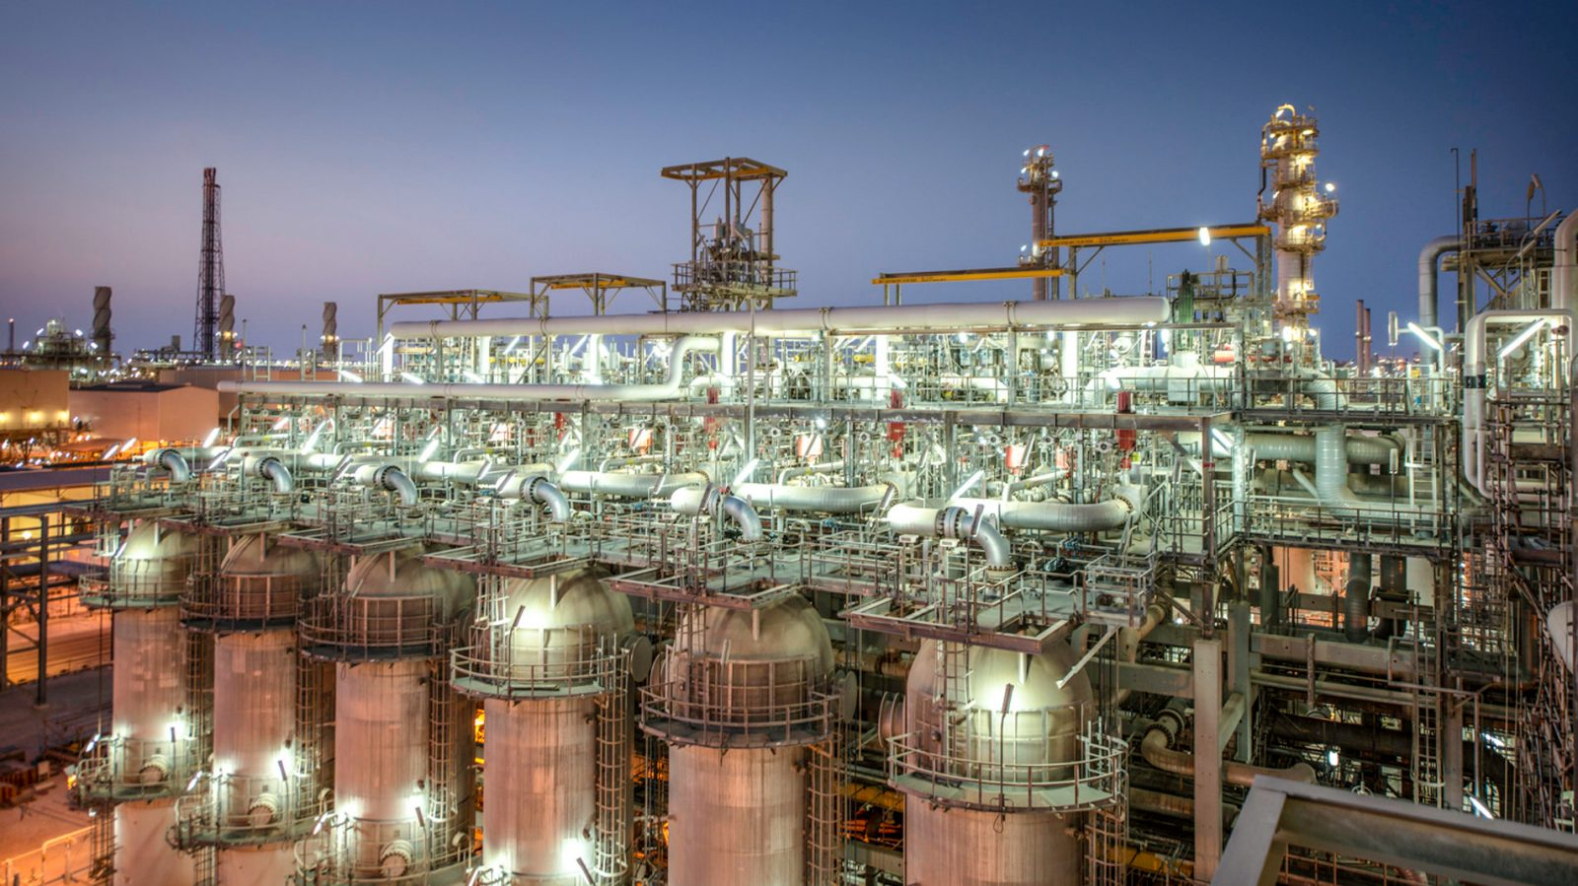
Personal Product - Industrial Process Digital TWIN Author: Manuel Portero

Slide 2
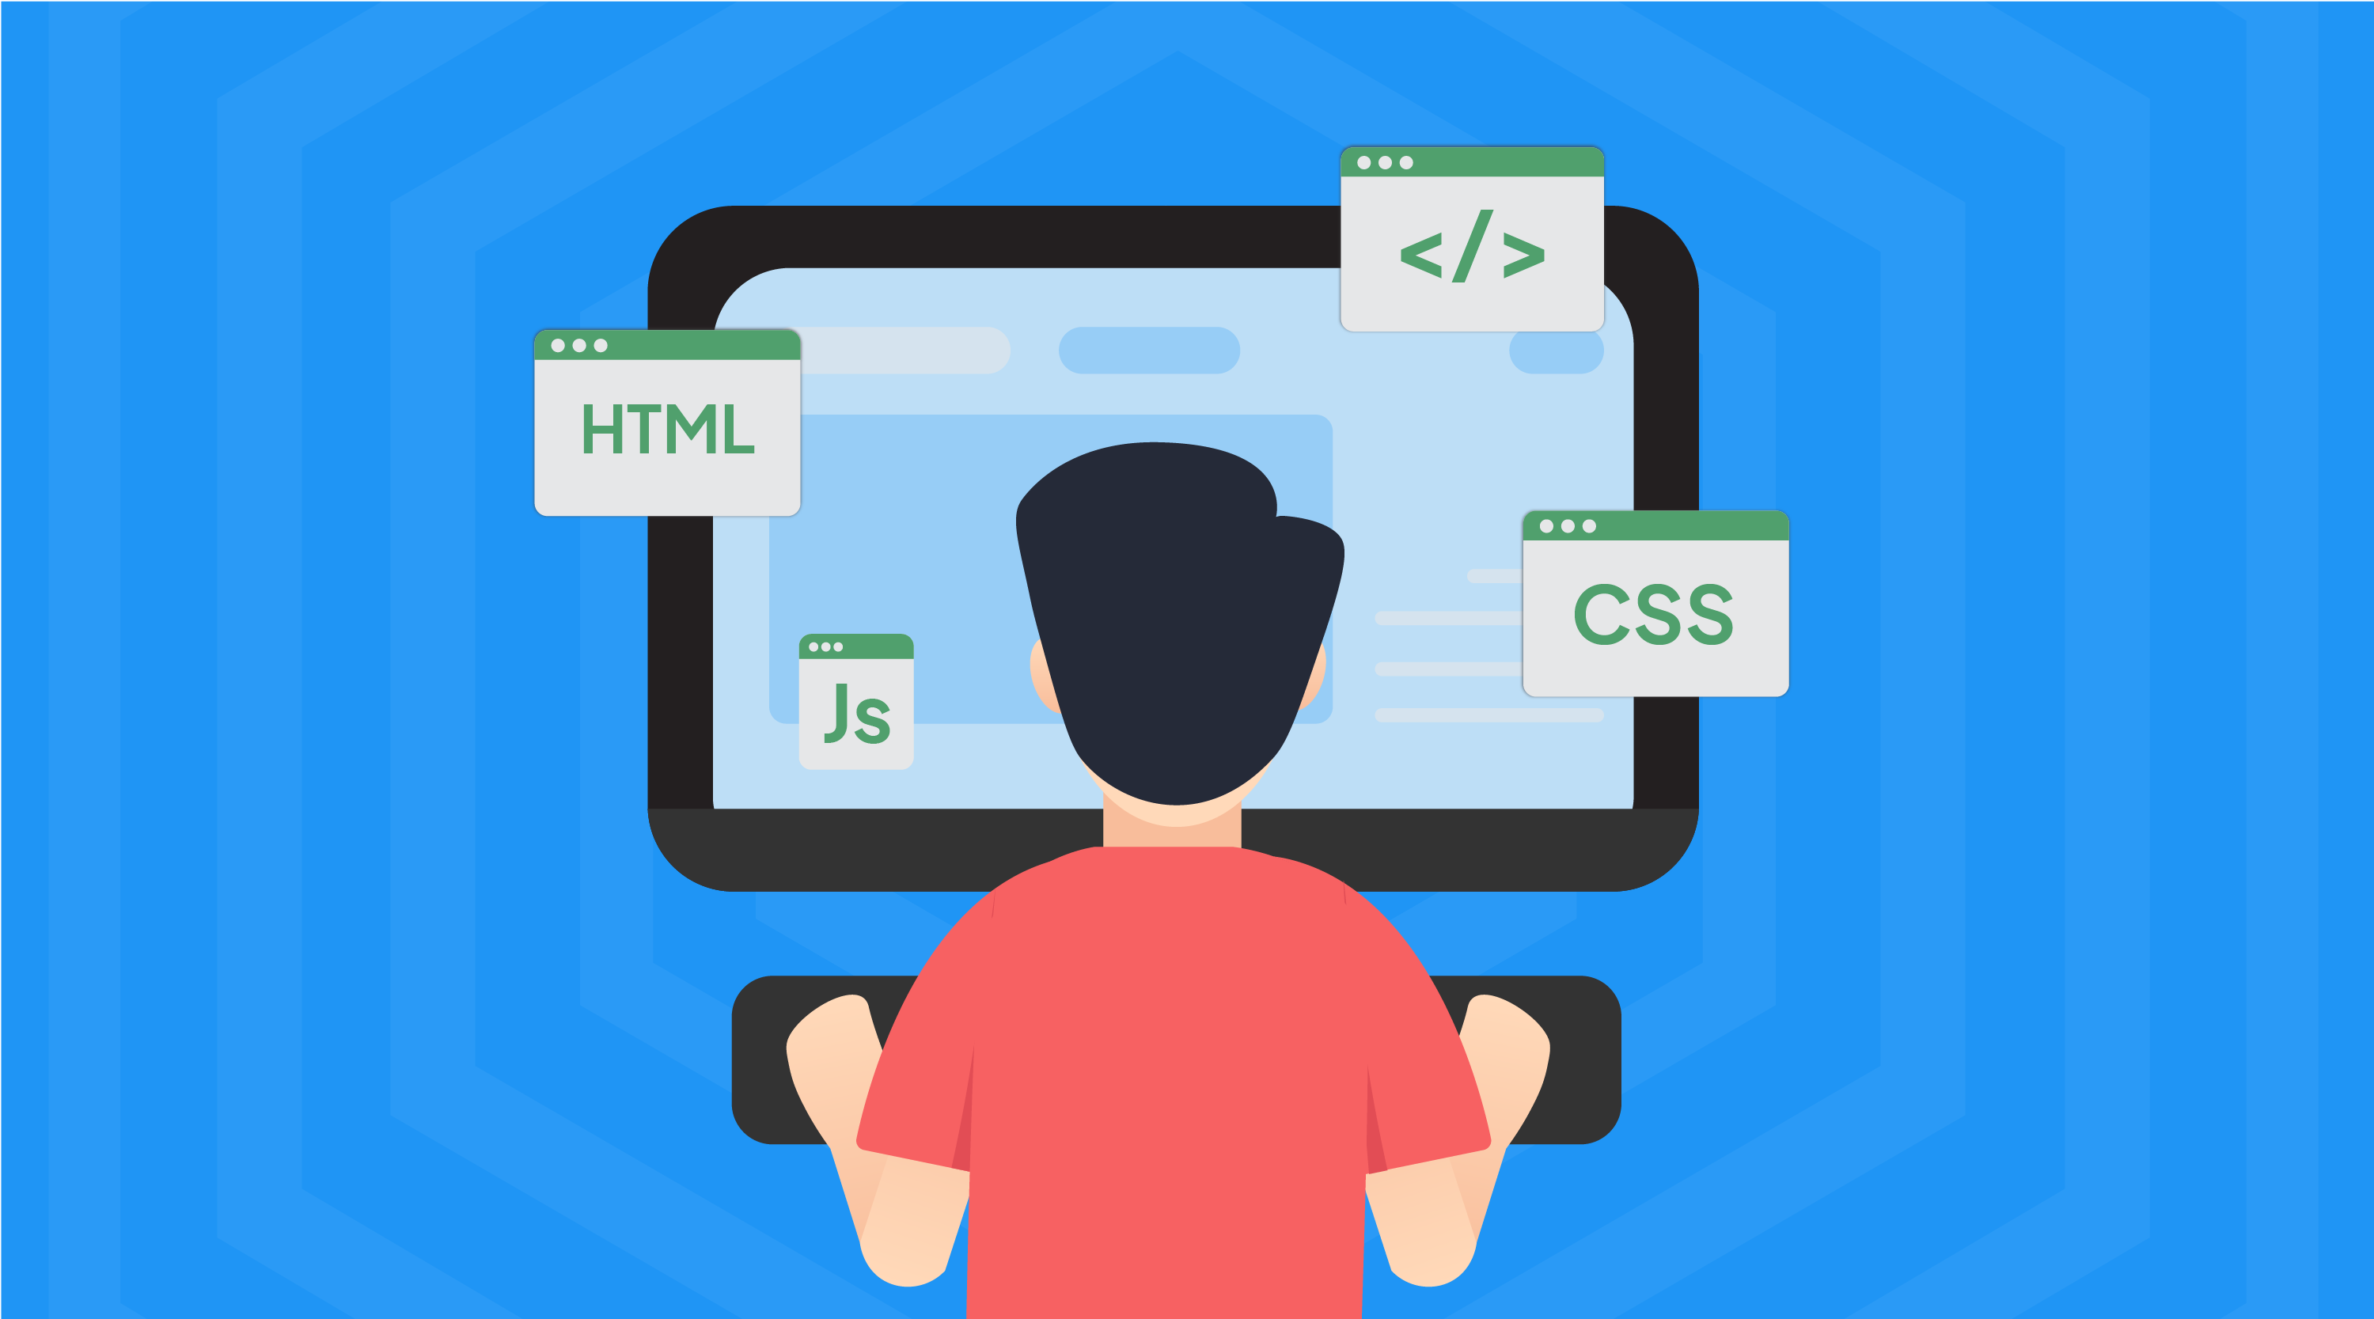
Personal Objectives
- Evolution the kind of exercises I'm doing creating full sellable solutions.
Emulate an industrial process for selling internally the solution to my actual team.
Elevate and master my actual skills in Pro Code, Cloud development and prebuilt and generative AI and extend the skillset to the Data Area ( CosmosDb, Data lake management, pro code AI ,etc.)
Elevate hard and soft skills harmonizing and levelling up all together ( Start working in my soft skillset ).

Slide 3
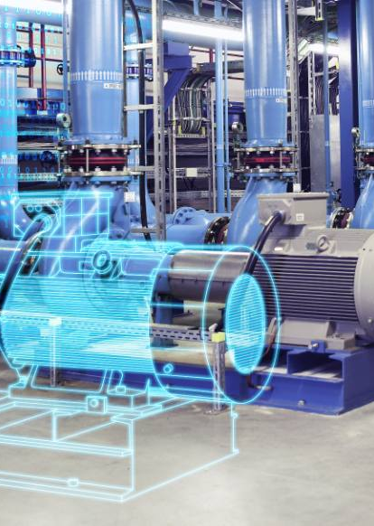
PROJECT BACKGROUND & DRIVERS
- Actually, most of the companies are not data driven companies.
Silos existing in between company departments.
No real time analysis and reaction in base of existing data.
No predictive actions are taken in base of existing data.
Companies are generating and implementing data strategies.
Enterprise are discovering new solutions for exploiting data.

Slide 4
Industry 4.0 Solutions Proposal
Digital twin creation
Advance GPT Chatbot ( AI assistant capable to query all production related information )
Real Time Dashboard solution of every company plant
Equiment's virtualization
Predictive mainteinance alert system

Slide 5
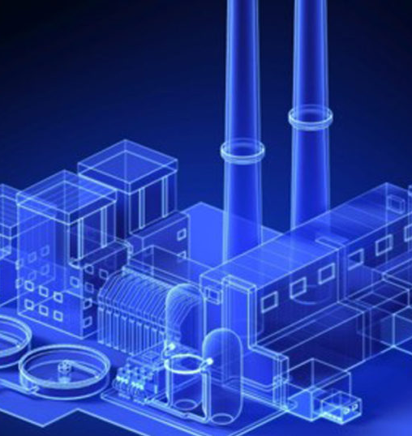
Solution Design

Slide 6
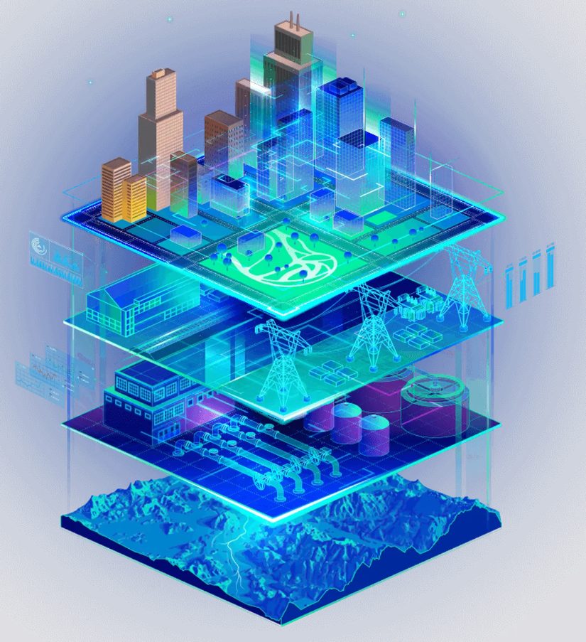
PRODUCT BEnefits
Change the way of working of engineering to reactive to proactive.
Break silos from all company departments with operations
Improvement in logistics, supply chain and sales (cost savings in transport, unitary cost of product discovery, operation predictive maintenance)
Industrial process optimization , optimizing productivity.

Slide 7
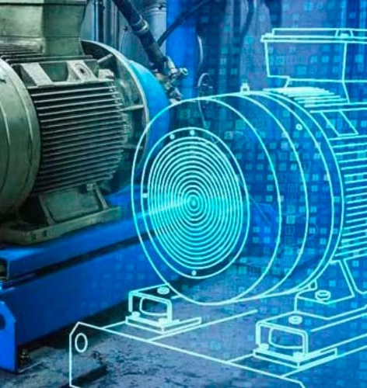
Solution Design

Slide 8
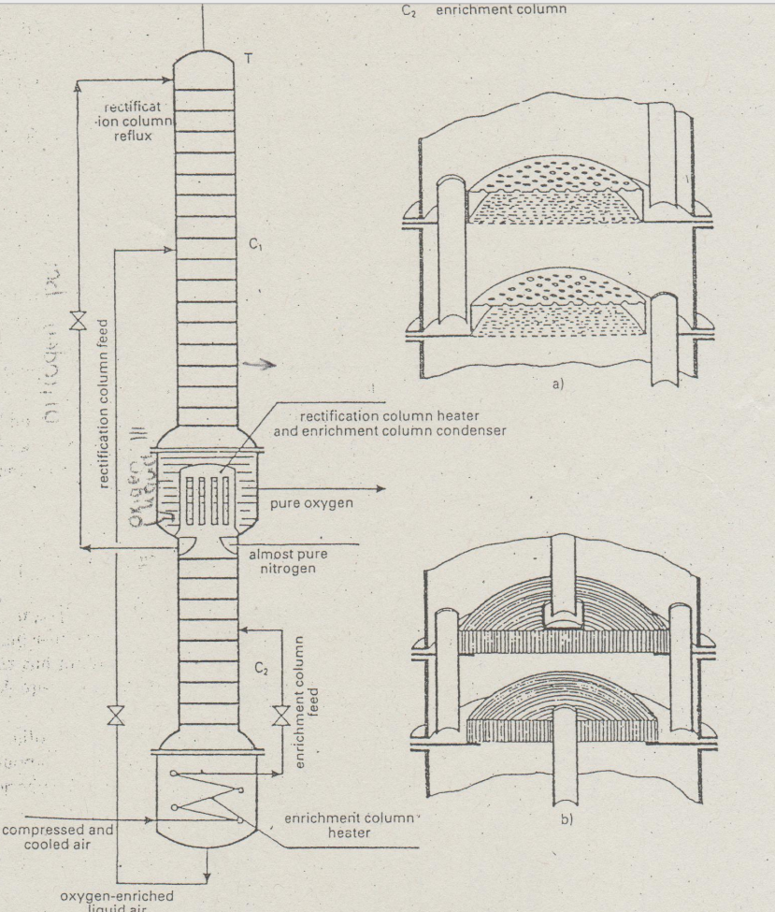
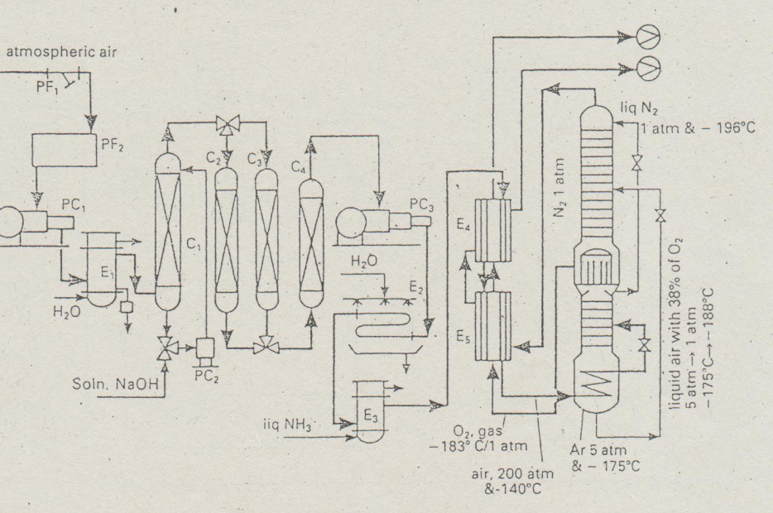
TArget industrial process

Slide 9
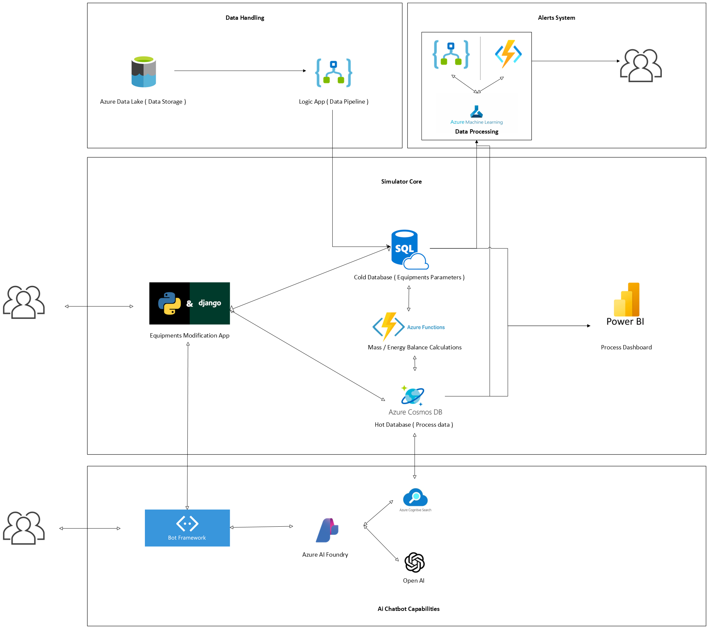
Solution Diagram
Solution Visio

Slide 10
Thank you
Manuel Portero
manuel.portero.leiva@gmail.com
www.profesionalwebsite-mpl.vercel.app

